Slide 1

SERVO MOTOR INTERFACING WITH 8051 MICROCONTROLLER
Members :
OM KHAIRNAR 430
AYUSH DUGADE 434
GOPALKRISHNA S. 435

Slide 2
Contents :
Introduction
Hardware Explanation
Outputs
Applications with advantages
Link to entire project repository
End of presentation

Slide 3
Introduction (Concept)
The presentation focuses on Interfacing servo motor on Microcontroller 8051 and studying how servo motor performs when provided different PWMs. Also checking the accuracy of servo motor by giving delay signals while moving from 0° to 180°.
The entire project is a simulation on Proteus.

Slide 4
Hardware Explanation
Requirements :
Servo Motor.
Microcontroller 8051.
5V Power supply.
Clock Circuit.
Reset Switch.
Software used :
Proteus & Keil μvision 5.

Slide 5
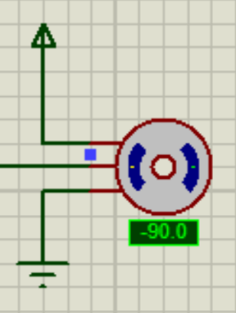
Hardware Explanation
Servo motor :
A servo motor is a type of electric motor that can rotate or move to a specific position, speed, or torque based on an input signal from a controller.
The input signal that control all these parameters is PWM(Pulse width modulation)
It is a signal in which a width of a square wave is modulated according to the operation of device.

Slide 6
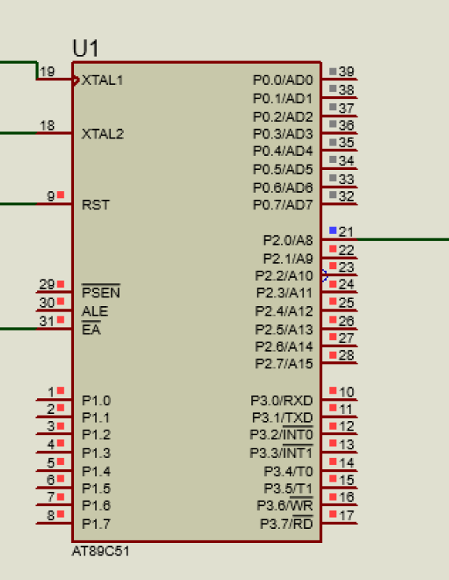
Hardware Explanation
Microcontroller 8051 :
It is a Microcontroller IC which includes it’s own inbuilt RAM, ROM, I/O Ports, Timers & Counters. The IC is application specific. This stands as a major reason it is widely used in various embedded systems and projects. It uses serial communication for communicating with computers & programming.

Slide 7
Hardware Explanation
5V Power Supply :
It is used to turn on Microcontroller 8051 & also run our Servo motor .
Clock Circuit:
It consists of a Crystal Oscillator which generates clock signals by it’s piezoelectric effect
Reset Circuit :
Used to reset the Microcontroller IC.

Slide 8
Code on Keil μvision 5.
#include<reg51.h>
sbit output=P2^0;
void msdelay(unsigned int time) // Function for creating delay in milliseconds.
{
unsigned i,j ;
for(i=0;i<time;i++)
for(j=0;j<1275;j++);
}
void servo_delay(int times) // Creating Delay using 8051 Timers
{
int m;
for(m=0;m<times;m++)
{
TH0=0xFF;
TL0=0xD2;
TR0=1;

Slide 9
Code on Keil μvision 5.
while(TF0==0);
TF0=0;
Code :
TR0=0;
}
}
void main()
{
int n;
TMOD=0x01; // Selecting Timer 0, Mode 1
output=0;
while(1)
{
for(n=13;n<28;n=n+2)
{
output=1;
servo_delay(n);
output=0;
servo_delay(260);
msdelay(200);
}
}
}

Slide 10
Output on Proteus

Slide 11
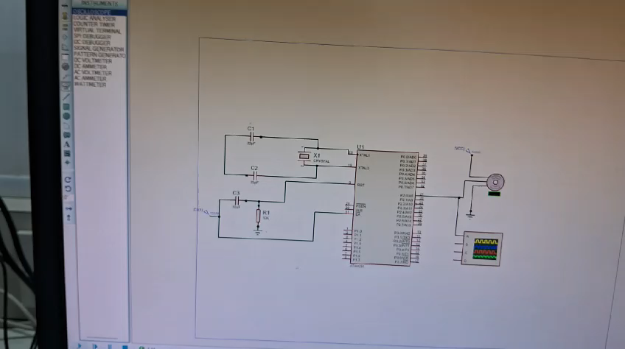
Output on Proteus

Slide 12
Advantages
Precision Control: Servo motors offer precise control over angular position, making them suitable for applications that require accurate movement, such as robotics, automation systems, and camera positioning.
Cost-Effectiveness: The 8051 microcontroller is known for its cost-effectiveness, making it an economical choice for projects with budget constraints.
Low-Level Programming: Programming the 8051 microcontroller in Assembly Language (ALP) provides low-level control and optimization options, allowing for efficient use of resources and precise timing control required for servo motor interfacing

Slide 13
Applications
Robotics
Automation Systems
Camera Positioning
Home Automation
Medical Devices, etc.

Slide 14
Link
https://github.com/omkhairnar/Servo-motor-Proteus
~ THANK YOU ~

